Slide 1

Customer Churn Prediction
Batch No: A-09 Project Guide:
G.Lavanya (164G1A0548) M.Soumya, M.Tech.
S.Bhargavi (164G1A0514 ) Assistant Professor
S.Ayesha (164G1A0508)
B.Kranthi Kumar (164G1A0541)
Srinivasa Ramanujan Institute of Technology
Department of Computer Science & Engineering

Slide 2
Abstract
Customer churn is a major problem and one of the most important concerns for large companies.
Due to the direct effect on the revenues of the companies, especially in the telecom field, companies are seeking to develop means to predict potential customer to churn.
Therefore, finding factors that increase customer churn is important to take necessary actions to reduce this churn.

Slide 3
Problem definition
Analysis of different Machine Learning Techniques on data, Compare accuracy of models and Factor Identification in Telecom Sector.

Slide 4
Existing System
The decision trees are the most commonly recognized methods used for prediction of problems associated with the customer churn.

Slide 5
Proposed System
Proposed churn prediction model produced better churn classification by comparing accuracy of different machine learning models and select more accurate model among them and customer profiling using k-means clustering.

Slide 6
Project planning
Requirement and Analysis
Data Collection and Cleaning
Data Preprocessing and Feature Selection
Churn Prediction and Factor identification
Testing Phase
Document Submission

Slide 7
Design
DFD-Level-0
Input data
Train
Algorithm
Build Model
New data
Use model
Prediction

Slide 8
DFD-Level-1
Input Dataset
Data Cleaning/
Preprocessing
Feature Selection
Data Splitting
Train Data
Test Data
Different Machine Learning Techniques
Model Performance metrics
Prediction
Accurate Model

Slide 9
Implementation
1. Loading the Dataset
2. Data Preprocessing
3. Feature Selection
a) Correlation
b) Information Gain
4. Customer Classification and Prediction
a) Applying Machine Learning Techniques
b) Churn /Nonchurn
5. Factor Identification
6. Customer Profiling and Relationship
a)Customer Profiling through Clustering

Slide 10
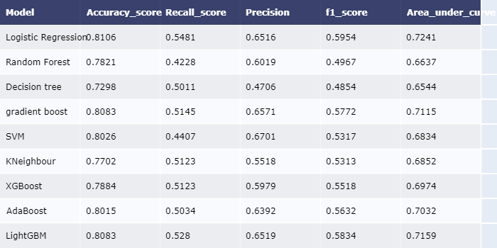

Slide 11
Literature Survey
N.Kamalraj and A.Malathi proposed “A Survey on Churn Prediction Techniques in Communication Sector”.
Ina Maryani1 and Dwiza Riana2 proposed “Clustering and Profiling of Customers Using RFM For Customer Relationship Management Recommendations”.

Slide 12
Requirements
Software System Configuration:-
Operating System : Windows 7/8/10
Python IDLE
Anaconda-Jupyter Notebook
Hardware Requirements
Processor - Intel i3
RAM - 4GB
Hard Disk - 1 TB

Slide 13
THANK YOU
Queries
?

